Slide 1
Technocrates Institute of Technology
Heart Disease Prediction
Using
Machine Learning With Python
Ujjwal Pandey ( 0111AL211173 )
Shivendra Patel ( 0111AL211155 )
Sonu Kumar Prajapati ( 0111AL211162 )
Yasir Ali ( 0111AL211186 )

Slide 2
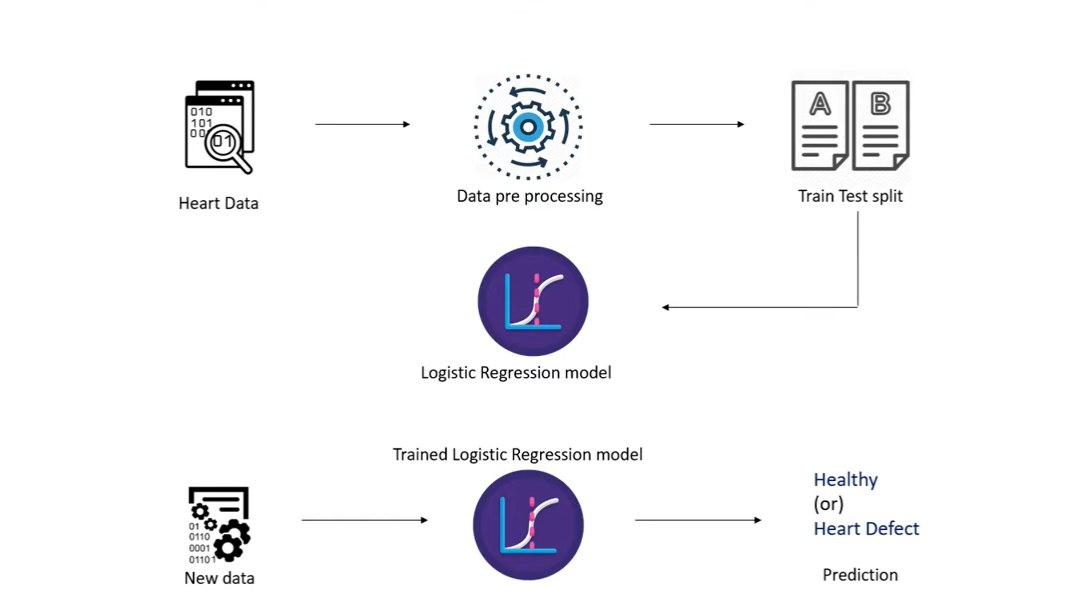
Working of The Project

Slide 3

Explaination
of
Each Steps
With
Questions
And
Their Answers

Slide 4
Step 1
1. Heart Data
This refers to the dataset that contains information related to patients' heart health. This dataset typically includes various features (attributes) such as age, sex, blood pressure, cholesterol levels, and other relevant medical metrics, as well as the target variable indicating the presence or absence of heart disease.
Steps :-
Acquire the Dataset : Obtain a dataset that contains medical data relevant to heart disease. For instance, the UCI Heart Disease dataset is commonly used.
Load the Dataset : Use libraries such as pandas to load the dataset into a Data Frame.
The UCI Heart Disease dataset is commonly used for this purpose.

Slide 5
Questions And Answers
Questions and Answers :
1. What kind of features are present in the heart disease dataset ?
Answer :
Features often include age, sex, chest pain type, resting blood pressure, serum cholesterol, fasting blood sugar, resting electrocardiographic results, maximum heart rate achieved, exercise-induced angina, ST depression induced by exercise, the slope of the peak exercise ST segment, number of major vessels colored by fluoroscopy, and a thalassemia condition indicator.
2. What is the target variable in the heart disease dataset ?
Answer :
The target variable is typically a binary indicator of the presence or absence of heart disease (e.g., 0 for no heart disease and 1 for heart disease).

Slide 6
Step 2
2. Data Preprocessing
Data preprocessing involves cleaning and transforming the raw data into a format that can be used by machine learning algorithms. This step typically includes handling missing values, encoding categorical variables, normalizing or scaling numerical features, and splitting the data into features and target variables.
Steps :-
Handle Missing Values : Check for and handle any missing data in the dataset.
Encode Categorical Variables : Convert categorical variables into numerical format using techniques such as one-hot encoding.
Normalize / Scale Features : Standardize or normalize numerical features to ensure they are on a similar scale.

Slide 7
Questions And Answers
Questions and Answers :
1. How do you handle missing values in the dataset ?
Answer :
Missing values can be handled by removing rows with missing data, imputing missing values using techniques like mean, median, or mode, or using advanced methods like K-nearest neighbors imputation.
2. Why do we need to encode categorical variables ?
Answer :
Machine learning algorithms require numerical input, so categorical variables must be converted into a numerical format using techniques like one-hot encoding or label encoding.
3. What is the purpose of normalizing or scaling numerical features ?
Answer :
Normalizing or scaling ensures that numerical features are on a similar scale, which helps improve the performance and convergence speed of many machine learning algorithms.

Slide 8
Step 3
3. Train-Test Split
This step involves splitting the dataset into two parts: a training set used to train the model and a testing set used to evaluate the model's performance.
Typically, a common split ratio is 80% training and 20% testing .
Step :-
Split the Data :
Use the train_test_split function from sklearn to split the dataset.

Slide 9
Questions And Answers
Questions and Answers :
1. What is the typical ratio for splitting the dataset into training and testing sets ?
Answer :
A common split ratio is 80% for training and 20% for testing, though 70-30 and 75-25 splits are also used depending on the dataset size.
2. Why is it important to split the dataset into training and testing sets ?
Answer :
Splitting the dataset allows us to train the model on one portion of the data and test its performance on another, ensuring that the model can generalize well to new, unseen data.

Slide 10
Step 4
4. Logistic Regression Model
Logistic regression is a statistical method for analyzing a dataset in which there are one or more independent variables that determine an outcome .
It is used for binary classification problems .
Steps :-
Initialize the Model : Create an instance of the Logistic Regression model.
Train the Model : Fit the model on the training data.
Evaluate the Model : Assess the model's performance on the testing data using metrics like accuracy, precision, recall, and F1 score.

Slide 11
Questions And Answers
Questions and Answers :
1. Why use logistic regression for heart disease prediction ?
Answer :
Logistic regression is suitable for binary classification tasks and provides a straightforward way to interpret the influence of different features on the prediction outcome.
2. What are some key parameters of the logistic regression model ?
Answer :
Key parameters include the regularization parameter `C`, the penalty type (`l1`, `l2`, `elasticnet`), and the solver used for optimization.

Slide 12
Step 5
5. New Data - Trained Logistic Regression Model - Prediction
Using the trained logistic regression model to make predictions on new, unseen data.
Steps :-
Prepare the New Data : Preprocess the new data in the same way as the training data.
Make Predictions : Use the trained model to predict the target variable for the new data.

Slide 13
Questions And Answers
Questions and Answers :
1. How do you make predictions on new data using the trained model ?
Answer :
Preprocess the new data similarly to the training data (handle missing values, encode categorical variables, normalize numerical features), and then use the `predict` method of the trained logistic regression model to obtain predictions.
2. How do you evaluate the performance of the logistic regression model ?
Answer :
Performance can be evaluated using metrics such as accuracy, precision, recall, F1-score, and the ROC-AUC score. Confusion matrices can also provide insight into the model's performance.

Slide 14
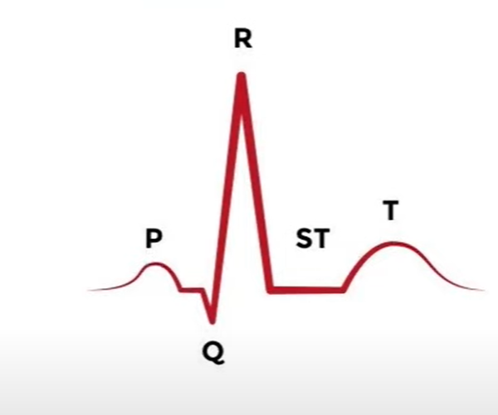
ECG Plays An Important Role !
Electrocardiogram (ECG or EKG) is a medical test that measures the electrical activity of the heart over a period of time. This test is essential in diagnosing various heart conditions by detecting irregularities in the heart's rhythm and structure.

Slide 15
ECG Plays An Important Role !
1. ECG Features :
- Resting ECG (restecg) : This feature indicates the results of an electrocardiographic test at rest. It can include :
- Normal ECG
- Having ST-T wave abnormality (T wave inversions and/or ST elevation or depression of > 0.05 mV)
- Showing probable or definite left ventricular hypertrophy by Estes' criteria
2. Max Heart Rate Achieved (thalach) : This feature is derived from exercise ECG and represents the highest heart rate achieved during the test.

Slide 16
ECG Plays An Important Role !
3. Exercise Induced Angina (exang) : Indicates if exercise-induced chest pain is present (1 = yes, 0 = no).
4. Oldpeak (oldpeak) : This feature represents the ST depression induced by exercise relative to rest, measured in millimeters.
5. Slope of the Peak Exercise ST Segment (slope) : Indicates the slope of the peak exercise ST segment, which can be :
- Upsloping
- Flat
- Downsloping

Slide 17
Working of Whole Project Is Based On Following Parameters
Age
Sex
Chest pain type (4 values)
Resting blood pressure
Serum cholestoral in mg/dl
Fasting blood sugar > 120 mg/dl
Resting electrocardiographic results (values 0,1,2)
Maximum heart rate achieved
Exercise induced angina
Oldpeak = ST depression induced by exercise relative to rest
The slope of the peak exercise ST segment
Tumber of major vessels (0-3) colored by flourosopy
thal: 0 = normal; 1 = fixed defect; 2 = reversable defect

Slide 18
Parameters
1. Age :
- Definition : The age of the patient in years.
- Relevance :Age is a significant risk factor for heart disease, with the risk increasing as people get older.
2. Sex :
- Definition : The gender of the patient, typically encoded as 1 for male and 0 for female.
- Relevance : Men are generally at higher risk of heart disease than women, especially at a younger age.
3. Chest Pain Type (cp) :
- Definition : Indicates the type of chest pain the patient experiences.
It has 4 values:
- 0: Typical angina (chest pain related to decreased blood supply to the heart)
- 1: Atypical angina (chest pain not related to heart problems)
- 2: Non-anginal pain (chest pain not related to the heart)
- 3: Asymptomatic (no chest pain)
- Relevance : Different types of chest pain can indicate different heart conditions or levels of severity.

Slide 19
Parameters
4. Resting Blood Pressure (trestbps) :
- Definition : The patient's blood pressure when at rest, measured in mm Hg.
- Relevance : High resting blood pressure (hypertension) is a major risk factor for heart disease and can damage arteries over time.
5. Serum Cholesterol (chol) :
- Definition : The cholesterol level in the patient’s blood, measured in mg/dl.
- Relevance : High levels of cholesterol can lead to atherosclerosis, which is a significant risk factor for heart disease
6. Fasting Blood Sugar > 120 mg/dl (fbs) :
- Definition : Indicates whether the patient’s fasting blood sugar level is greater than 120 mg/dl (1 = true; 0 = false).
- Relevance : High fasting blood sugar levels can indicate diabetes, which is a risk factor for heart disease.

Slide 20
Parameters
7. Resting Electrocardiographic Results (restecg) :
- Definition : The results of the resting electrocardiogram.
It has 3 values:
- 0: Normal
- 1: Having ST-T wave abnormality (e.g., T wave inversions and/or ST elevation or depression of > 0.05 mV)
- 2: Showing probable or definite left ventricular hypertrophy by Estes' criteria
- Relevance : Abnormal ECG results can indicate heart problems such as ischemia or hypertrophy.
8. Maximum Heart Rate Achieved (thalach) :
- Definition : The highest heart rate achieved by the patient during an exercise test.
- Relevance : A lower than expected maximum heart rate can indicate poor heart function.
9. Exercise Induced Angina (exang) :
- Definition : Indicates whether the patient experiences angina (chest pain) induced by exercise (1 = yes; 0 = no).
- Relevance : Exercise-induced angina is a sign of heart disease and poor blood flow to the heart during physical activity.

Slide 21
Working of Whole Project
10. Oldpeak :
- Definition : ST depression induced by exercise relative to rest, measured in mm.
- Relevance : ST depression can indicate ischemia, which is a condition where the blood flow (and thus oxygen) is restricted to a part of the body.
11. Slope of the Peak Exercise ST Segment (slope) :
- Definition : The slope of the peak exercise ST segment.
It has 3 values :
- 0: Upsloping
- 1: Flat
- 2: Downsloping
- Relevance : The slope of the ST segment during exercise can provide information about the heart's response to stress and potential blockages.
12. Number of Major Vessels Colored by Fluoroscopy (ca) :
- Definition : The number of major blood vessels (0-3) that are colored by fluoroscopy.
- Relevance : A higher number of colored vessels typically indicates more severe heart disease.

Slide 22
Parameters
13. Thalassemia (thal) :
- Definition : A blood disorder involving less than normal amounts of an oxygen-carrying protein.
It has 3 values :
- 0: Normal
- 1: Fixed defect (permanent damage)
- 2: Reversible defect (potentially treatable)
- Relevance : Thalassemia can affect the heart's ability to function properly, especially in severe cases.
14. Target :
It shows that a person is having heart disease or not .
0 – Healthy Heart
1 – Unhealthy Heart

Slide 23
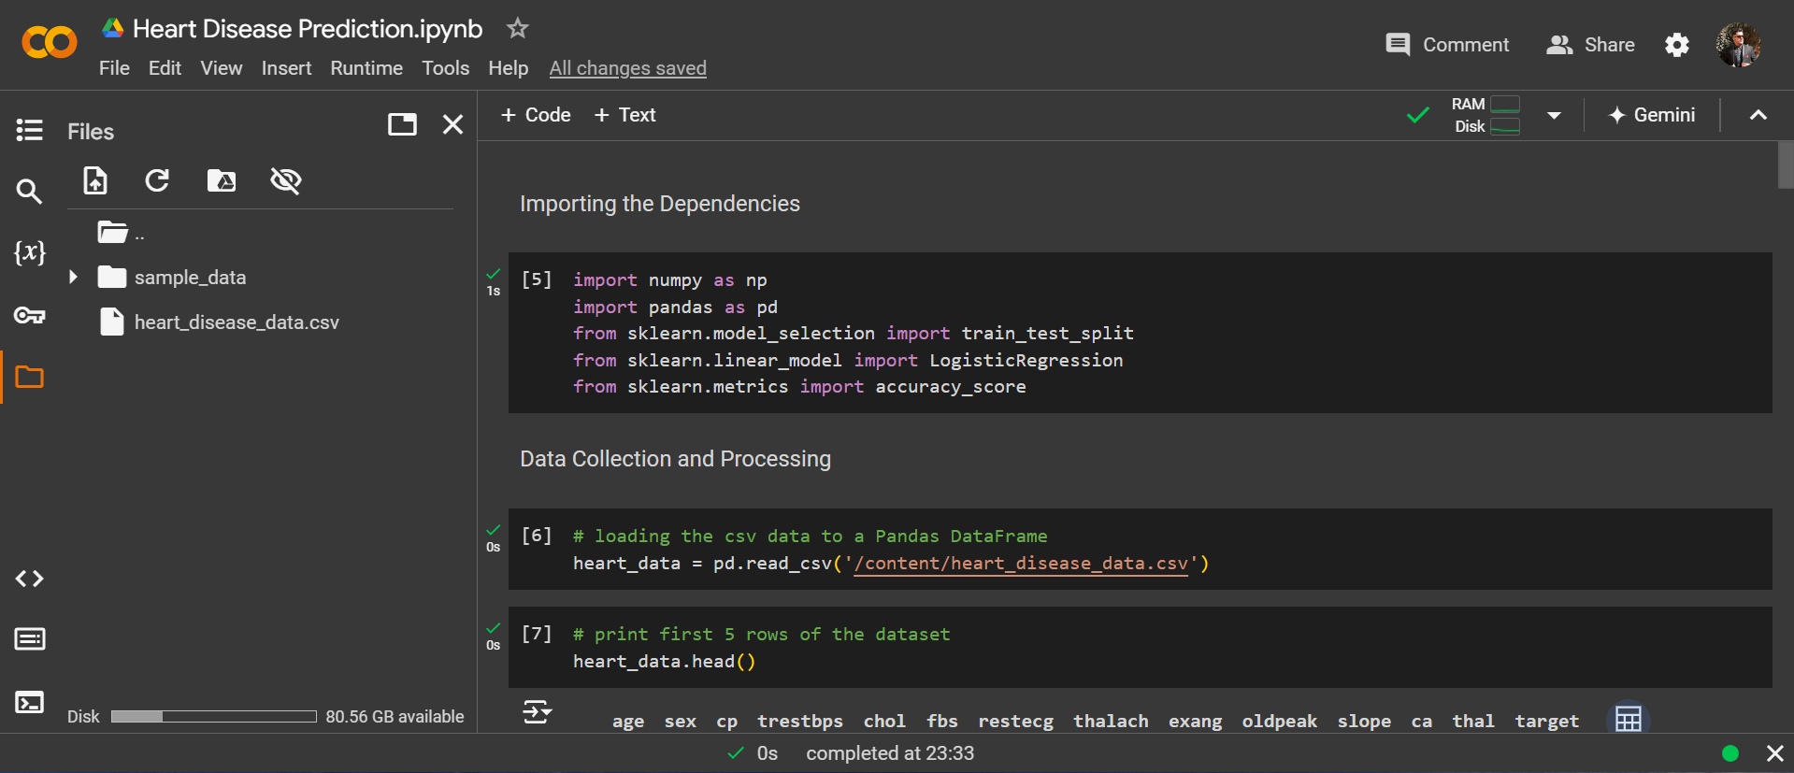
We have Used Google Colab For Project Making !

Slide 24
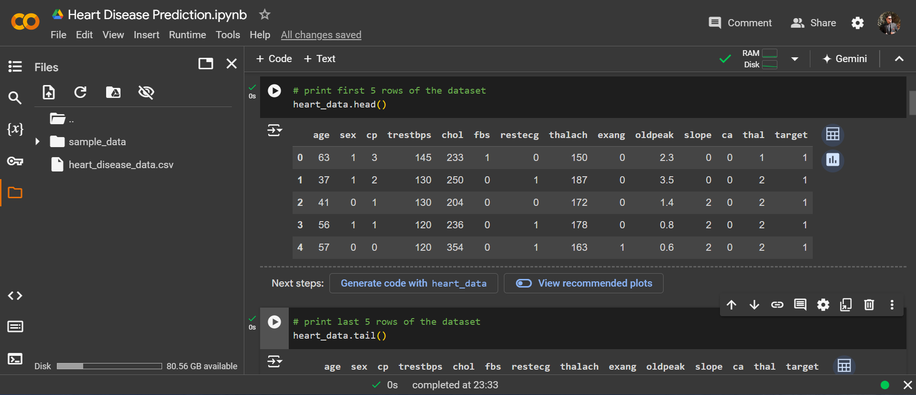

Slide 25
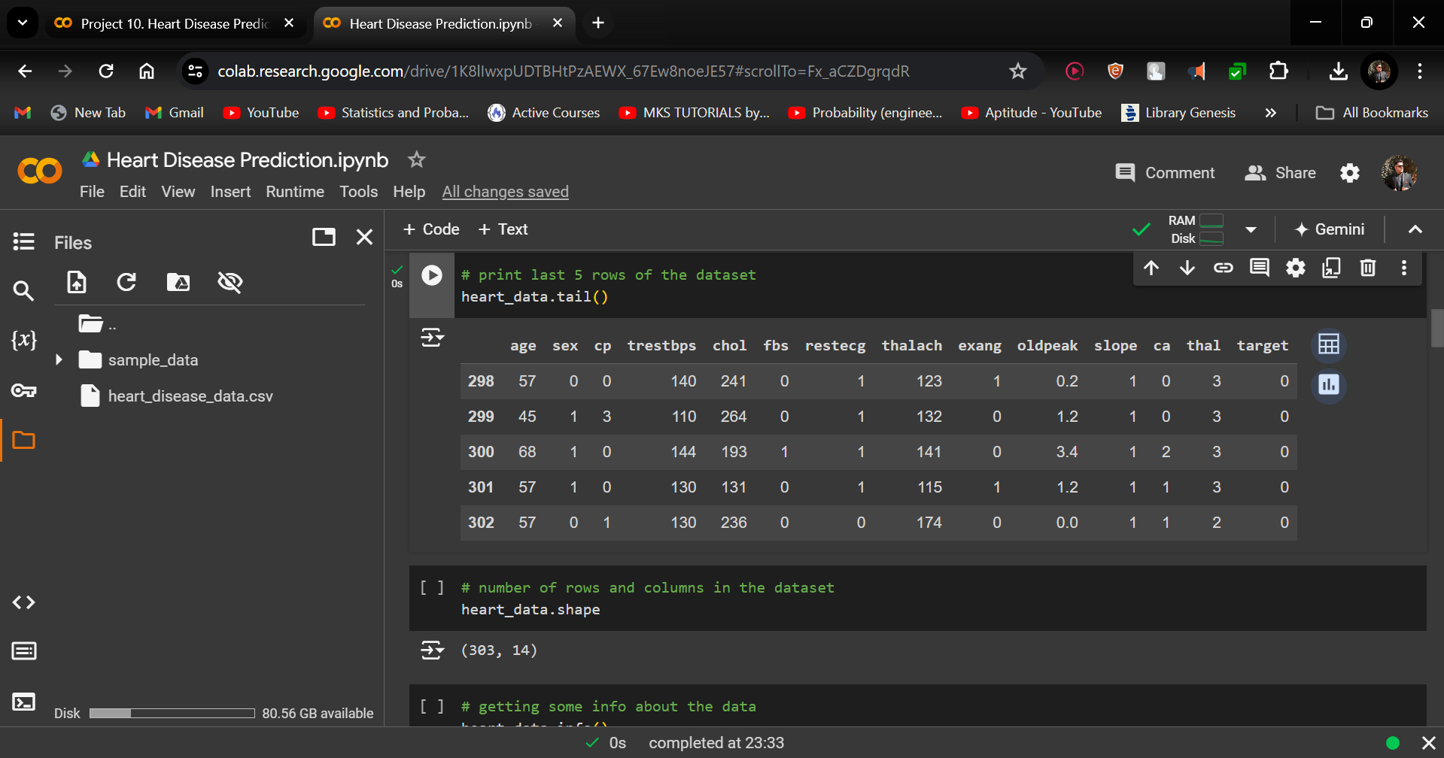

Slide 26
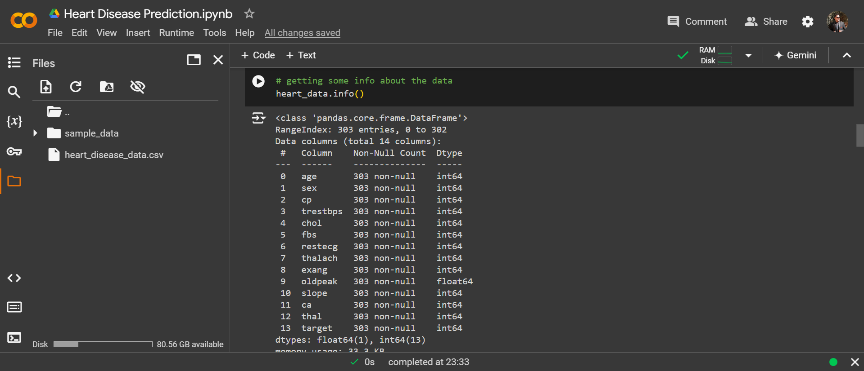

Slide 27
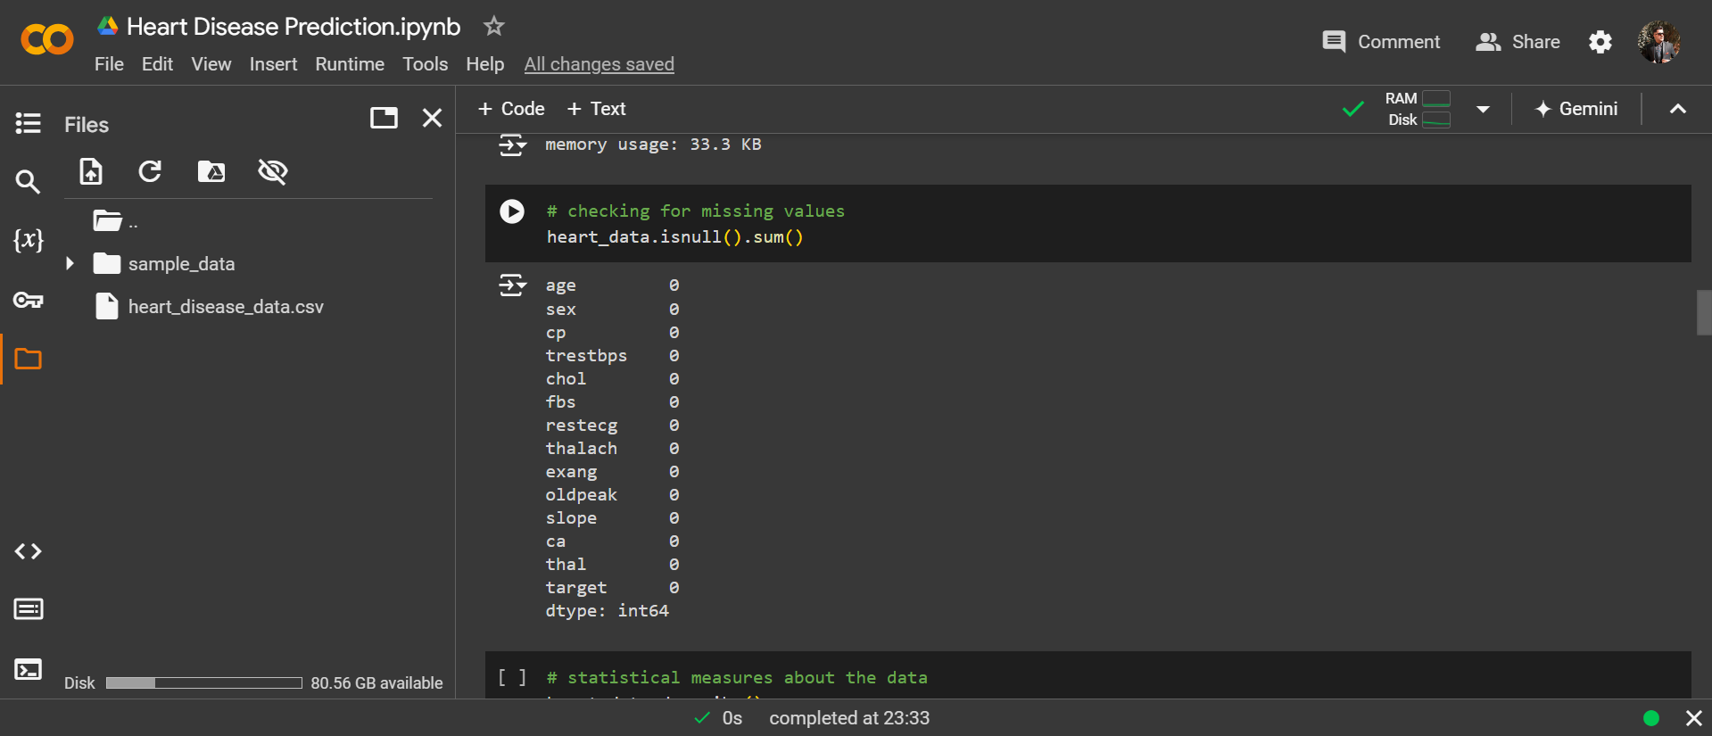

Slide 28
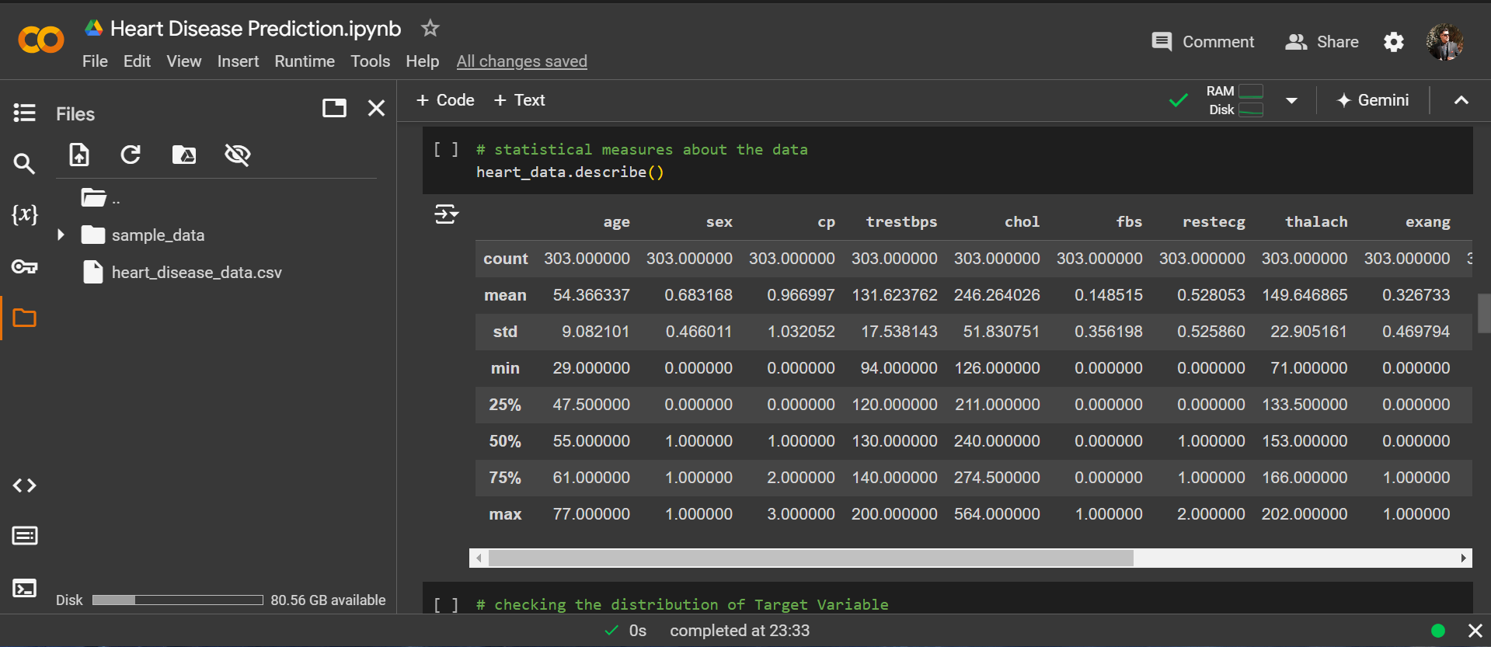

Slide 29
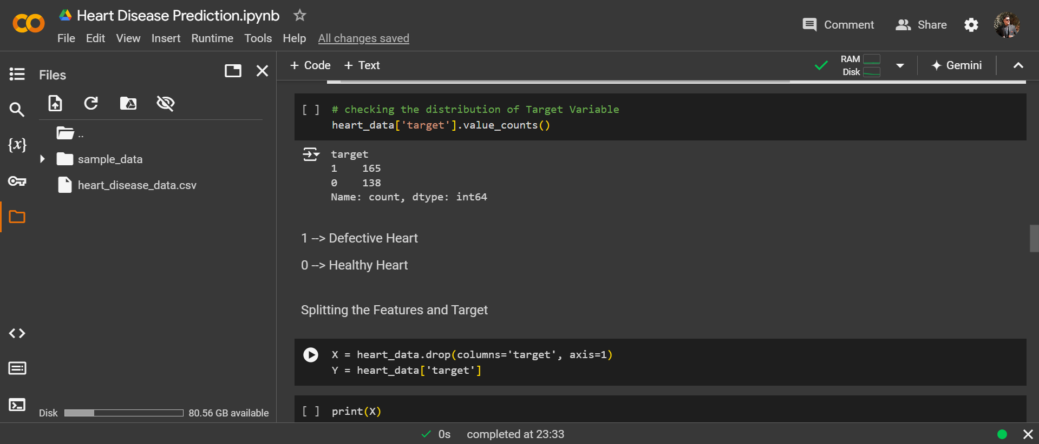

Slide 30
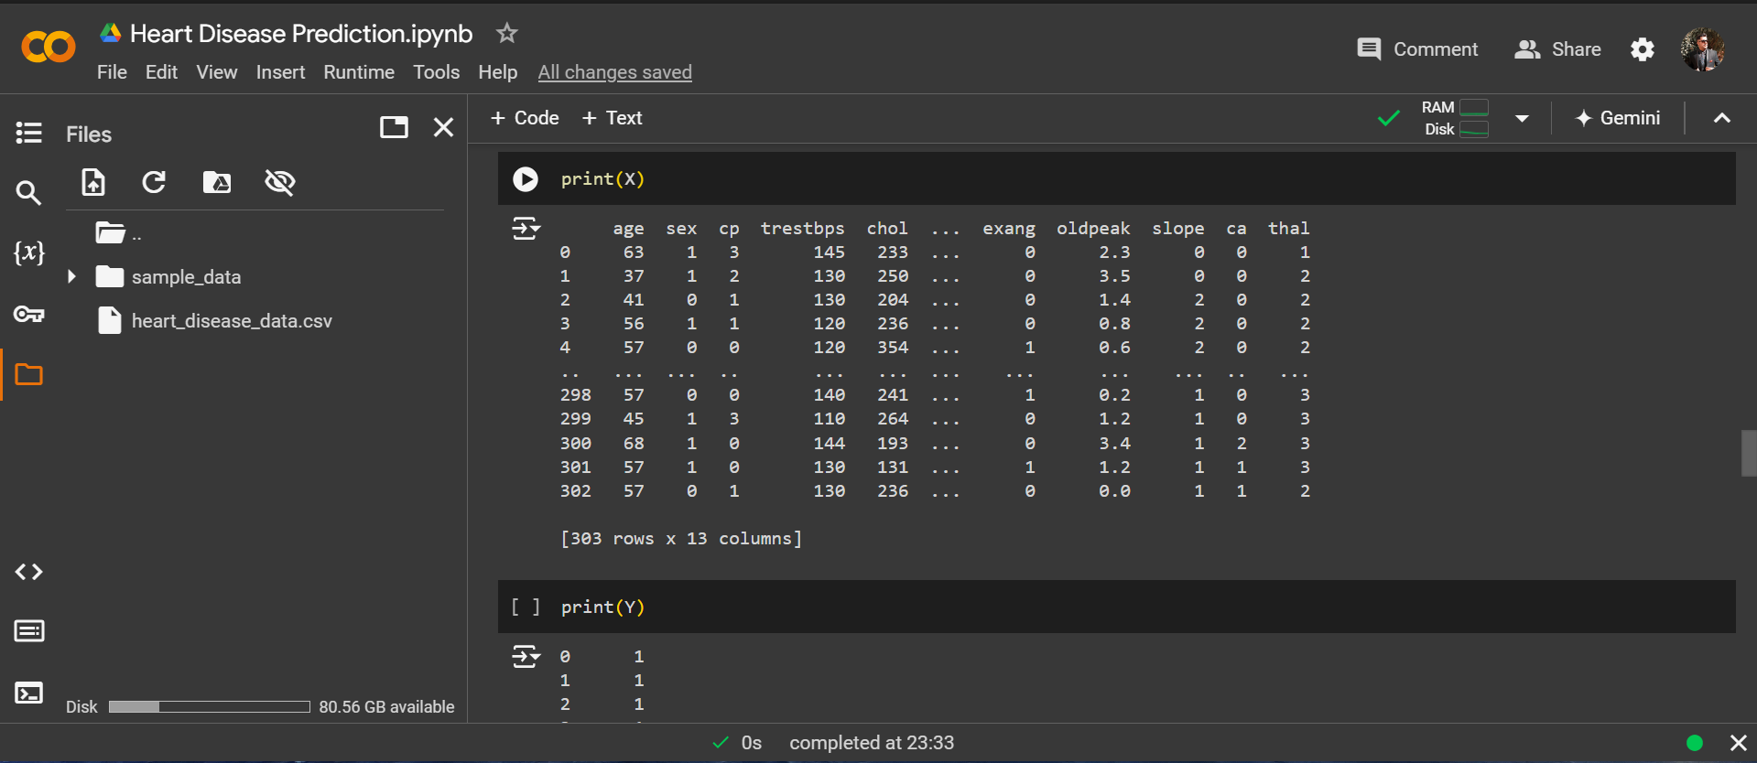

Slide 31
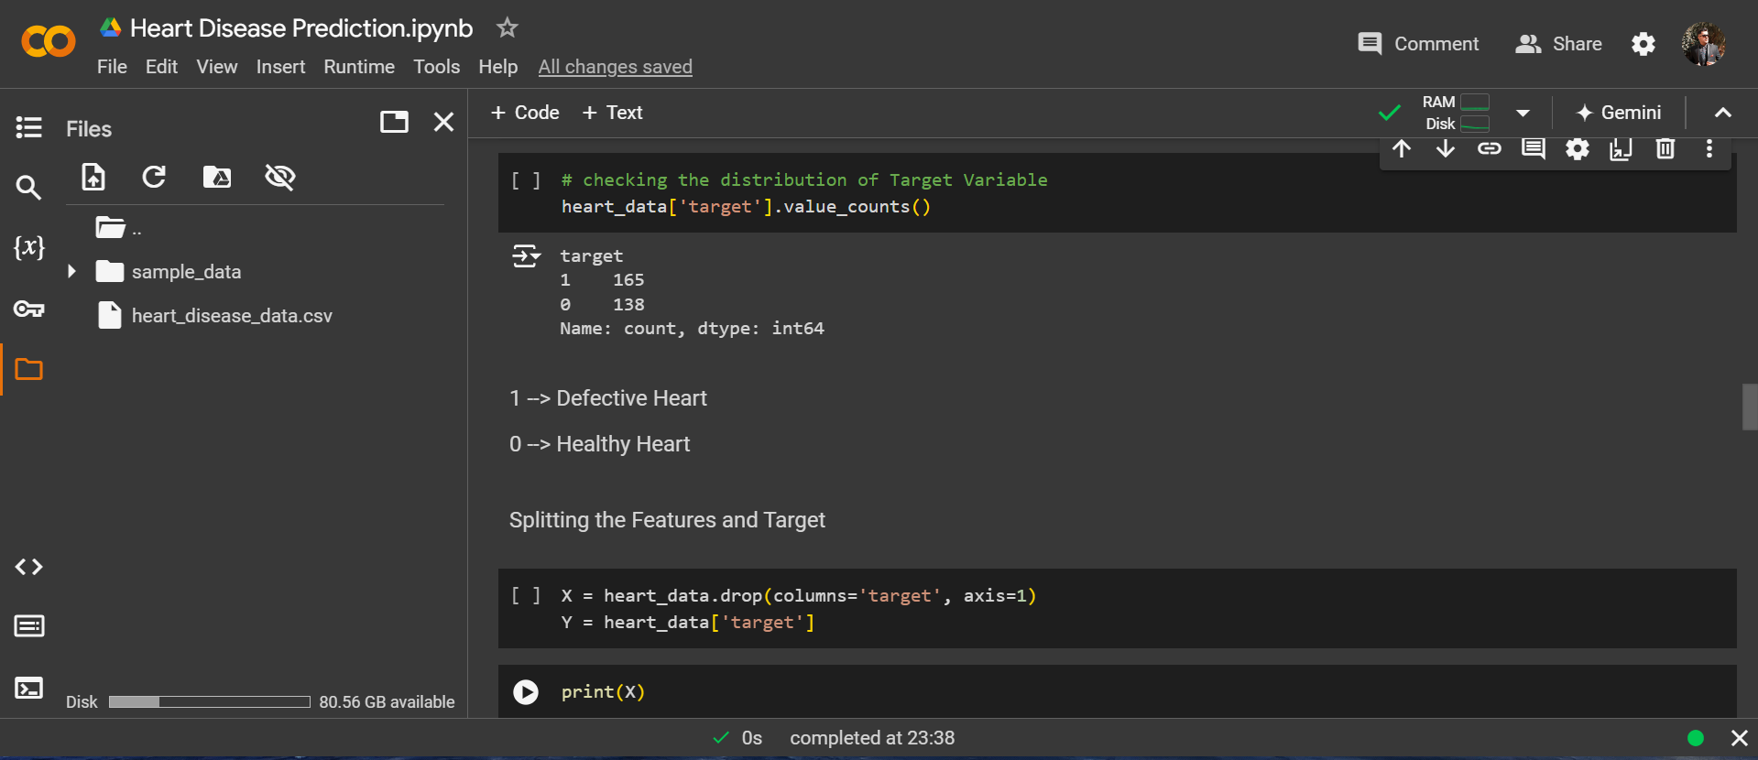

Slide 32
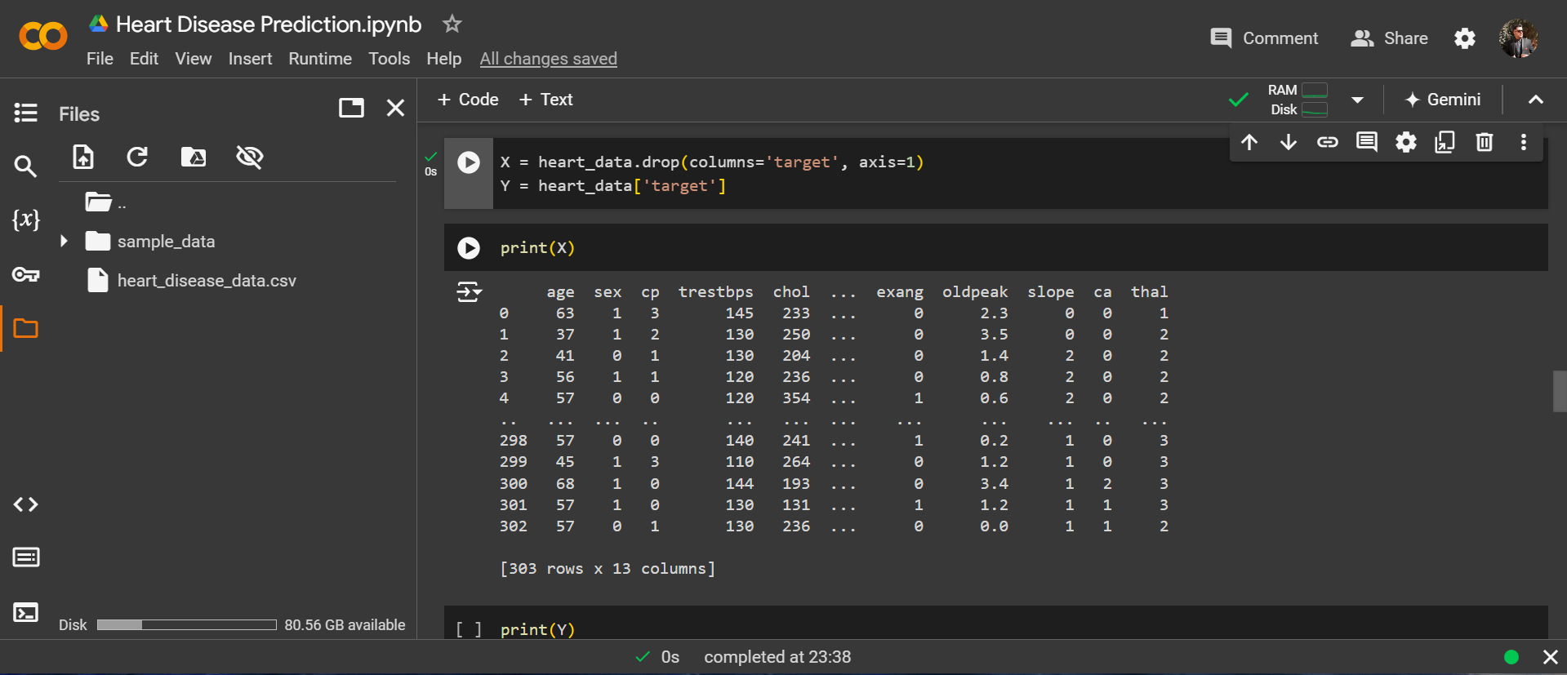

Slide 33
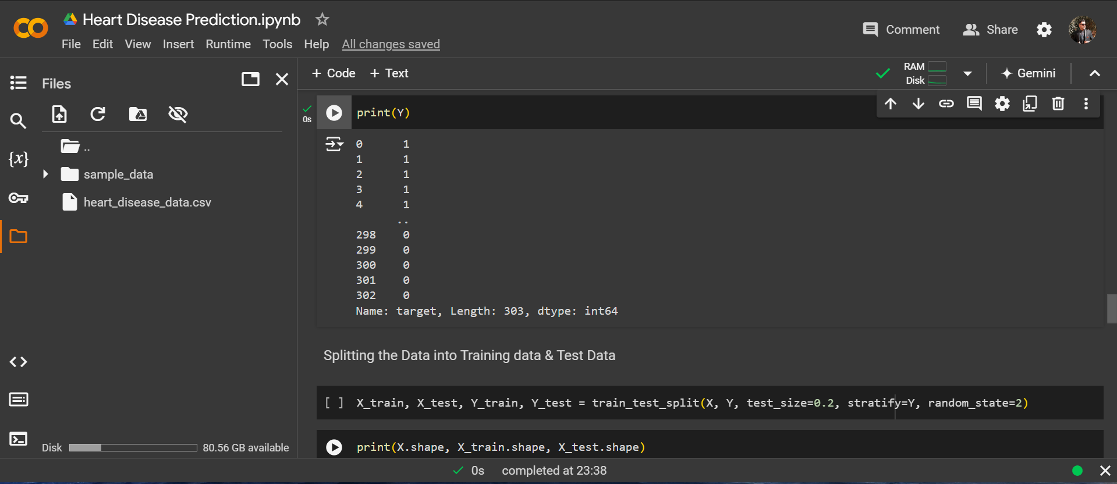

Slide 34
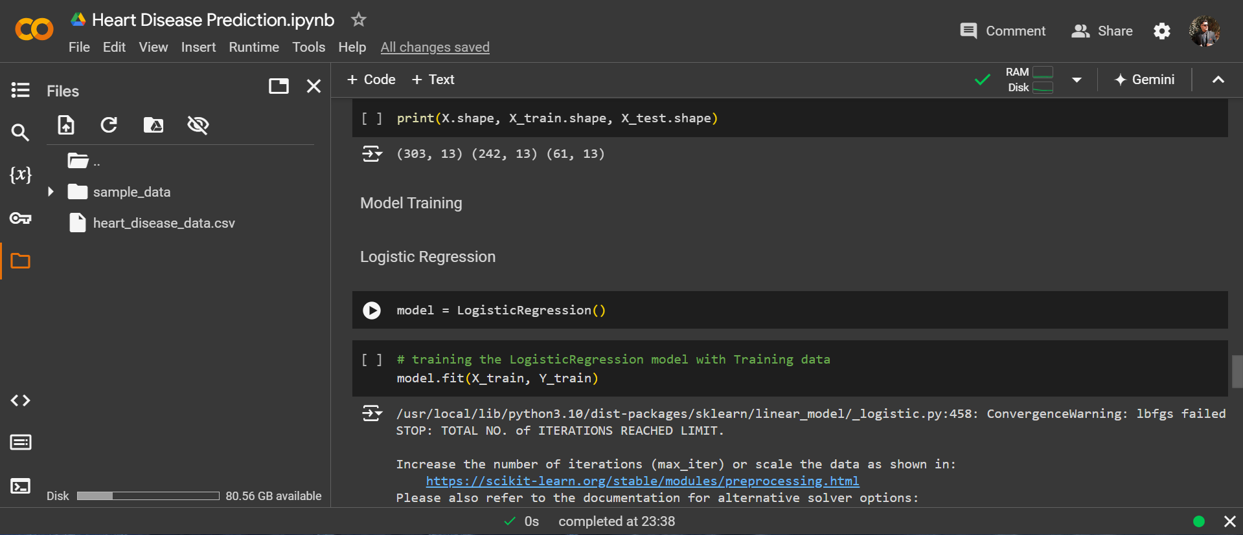

Slide 35
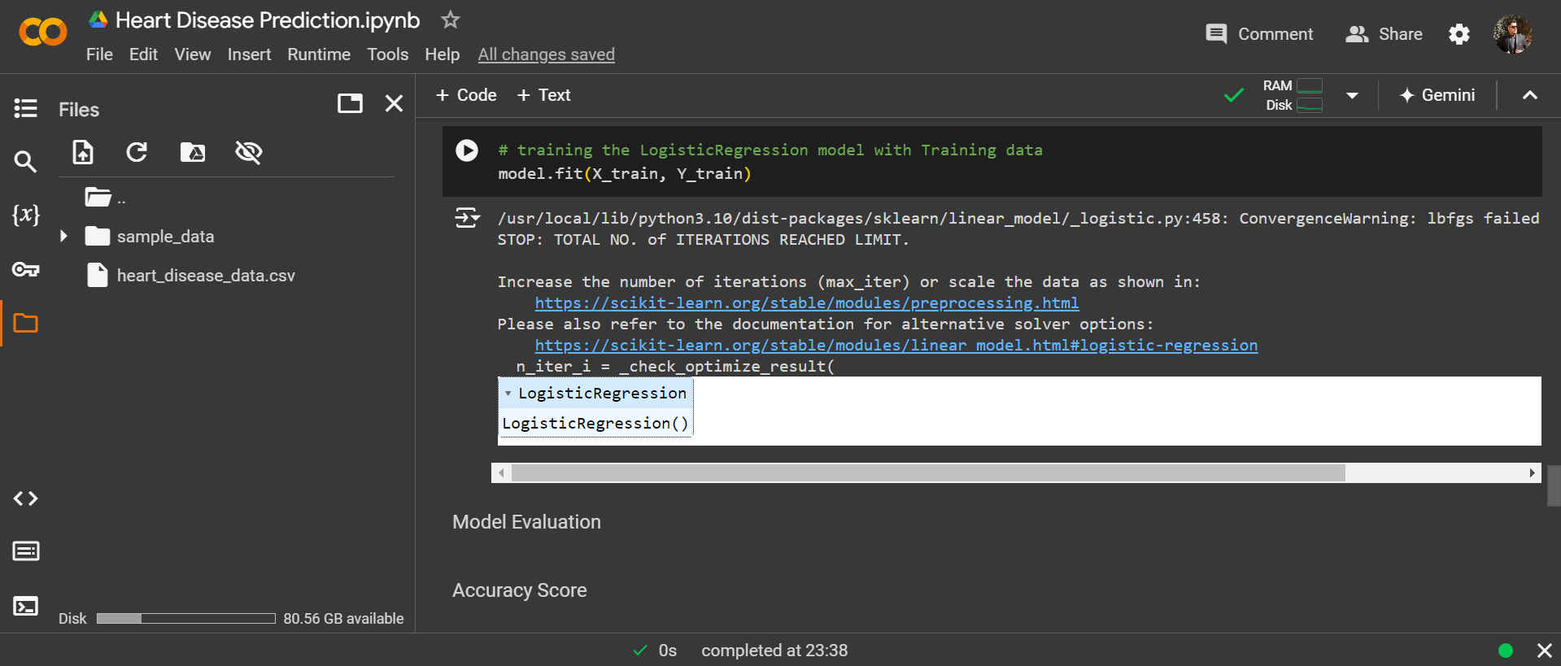

Slide 36
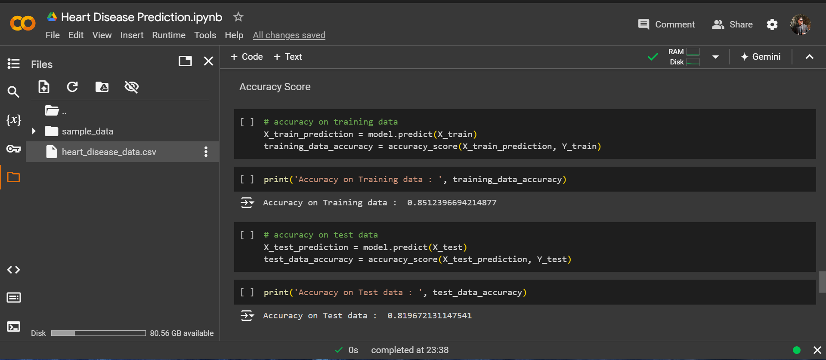

Slide 37
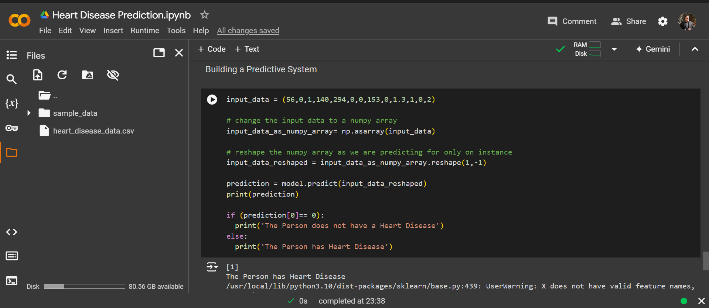

Slide 38
Thank You !
All the information , coding , writing and research has been done by whole team !
Reference : KAGGLE And GOOGLE .

